Slide 1

DISCIPLINE SPECIFIC CORE-
Theory of Computation Unit 4 Turing Machines and Models of Computations
BY:
Harsh Arora
Hardik Bhanaya
Harshita Singh

Slide 2

Turing machine as a model of computatione
1
2
Configuration of Turing machine
CONTENTS
3
Recursive and recursively enumerable languages
4
5
Universal Turing Machine
Church-Turing Thesis

Slide 3
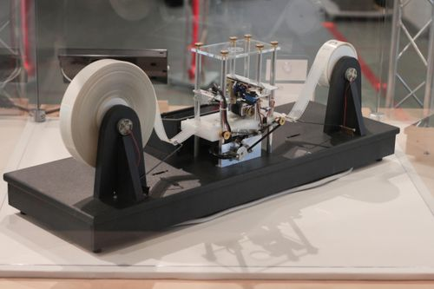
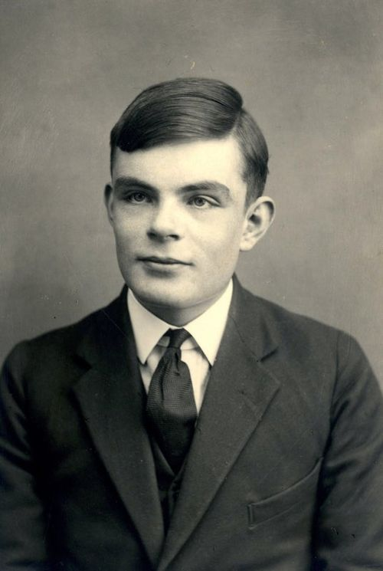
1
Turing Machine
A Turing Machine is an abstract mathematical model capable of simulating any algorithmic process through a set of predefined operations.
It operates using an infinite tape divided into cells, which acts as memory, allowing it to read, write, and store symbols as it computes.
The machine follows specific rules based on its current state and the symbol it reads, moving left or right and changing states as necessary.
Developed by Alan Turing in 1936, the Turing Machine forms the foundation of modern theories of computation and complexity.

Slide 4
Uses of Turing Machine
01
Turing Machines are used to understand the limits of what can be computed, defining which problems are solvable by algorithms.
They help in analyzing algorithm efficiency and complexity, forming a basis for classes like P, NP, and undecidable problems.
Turing Machines serve as a foundation for developing more complex computational models and modern computer architectures.
They provide a theoretical framework for studying automata, formal languages, and the nature of computation itself.

Slide 5

Components of Turing Machine
01
Infinite Tape: The tape is divided into cells, each holding a symbol. It serves as the machine's memory and is considered infinite for computation.
Read/Write Head: The head moves along the tape, reading symbols and writing new ones based on the current state and rules.

Slide 6
Components of Turing Machine
01
State Register: Holds the current state of the machine, determining the actions to take based on the read symbol.
Transition Rules: Define the machine’s behavior by specifying what the machine should do (move, write, or change states) based on the symbol read and the current state.

Slide 7
Formal Definition of a Turing Machine
01
A TM is expressed as a 7-tuple (Q, T, B, ∑, δ, q0, F) where:
Q is a finite set of states
T is the tape alphabet (symbols which can be written on Tape)
B is blank symbol (every cell is filled with B except input alphabet initially)
∑ is the input alphabet (symbols which are part of input alphabet)
δ is a transition function which maps Q × T → Q × T × {L,R}. Depending on its present state and present tape alphabet (pointed by head pointer), it will move to new state, change the tape symbol (may or may not) and move head pointer to either left or right.
q0 is the initial state
F is the set of final states. If any state of F is reached, input string is accepted.

Slide 8
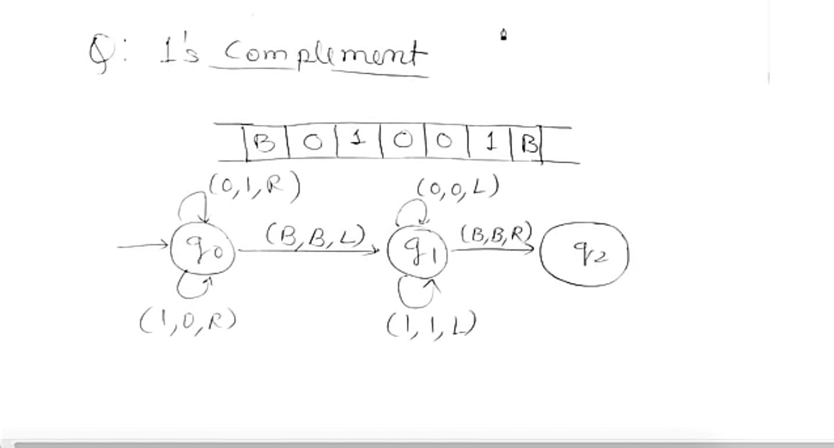
1’s Complement
01

Slide 9
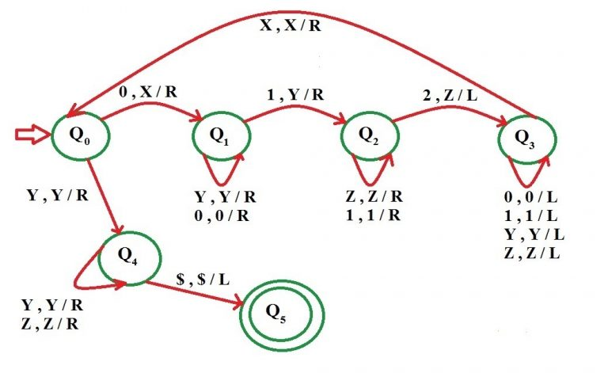
Construct a Turing Machine for language L = {0n1n2n | n≥1}
01

Slide 10
2
Recursive and recursively enumerable languages
Logo

Slide 11
Halt
01
Halt refers to the situation where a Turing Machine stops its computation, either by reaching a final state or having no valid transitions left.
When the machine halts in a final state, the input is accepted; if it halts in a non-final state, the input is rejected.
The Halting Problem states that it is undecidable to determine whether a Turing Machine will halt on a given input.

Slide 12
01
Recursive Languages:
Decidable: A language is recursive (or decidable) if there exists a Turing Machine that will always halt and correctly decide whether a string belongs to the language or not.
Always Halts: For any input string, a recursive language’s corresponding Turing Machine will always halt, either accepting or rejecting the string.

Slide 13
01
Recursively Enumerable Languages:
Partially Decidable: A language is recursively enumerable (RE) if there exists a Turing Machine that will accept strings in the language, but it may not halt for strings not in the language.
May Not Halt: For strings not in the language, the corresponding Turing Machine might run indefinitely, meaning it doesn't provide a definite "reject" result.

Slide 14
3
Universal Turing Machine

Slide 15

01
Universal Turing Machine
A Universal Turing Machine (UTM) is a theoretical machine capable of simulating any other Turing Machine
It takes as input both the description of the machine to be simulated and the input for that machine.
The UTM follows the transition rules of the described machine to perform computations on the input.
This concept laid the foundation for general-purpose computers, illustrating that one machine can perform any computable task.

Slide 16
01
Construction of UTM
Without loss of generality, we assume the following for M:
Q = {q1, q2, ….qn} where q1=initial state and q2=Final State
τ = {σ1, σ2,,…σn} where σ represent blanks
Select an encoding on which q1 is representable by 1, q2 by 11, and so on.
Similarly, σ1 is encoded as 1, σ2 as 11, etc.
Finally, let us represent R/W head directions by 1 for L (Left) and 11 for R(Right).
The symbol 0 will be used as a separator between 1s.

Slide 17
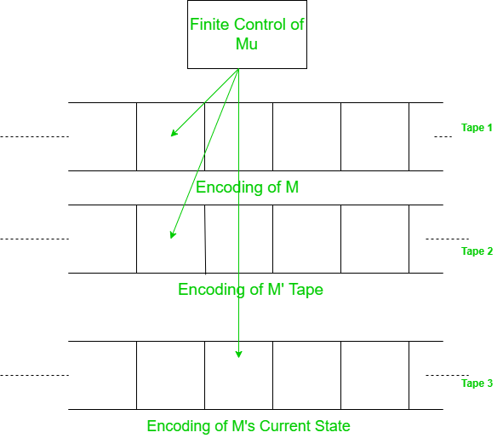
01
Implementation of UTM
A UTM Mu then has an input alphabet = {0, 1} and the structure of a multi-tape TM.
Mu looks first at the contents of Tape 2 and Tape 3 to determine the instantaneous
description (ID) of M.
It then consults Tape1 to see what
M would do with this ID.
Finally, Tape 2 and Tape 3 will be
modified to reflect the result of the
move.

Slide 18
4
Turning Chruch Thesis
Logo

Slide 19
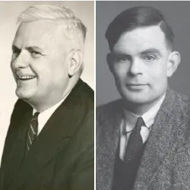
01
Turing Church Thesis:
The Church-Turing Thesis asserts that any computation that can be performed by a human using an algorithm can also be computed by a Turing Machine.
It was independently proposed by Alonzo Church and Alan Turing in the 1930s through different formal systems, namely lambda calculus and Turing Machines.
The thesis suggests that Turing Machines and similar computational models capture the essence of what is computable, providing a universal definition of computability.
While the Church-Turing Thesis cannot be formally proven, it is widely accepted as the foundation for understanding the limits of computation in computer science.

Slide 20
01
Undecidability
Undecidability refers to the property of certain problems that cannot be solved by any algorithm or computational procedure
The Halting Problem is a classic example of an undecidable problem, proven by Alan Turing, which asks whether a given Turing Machine will halt on a specific input.
Other examples of undecidable problems include the Post Correspondence Problem and the Word Problem for Groups, where no general solution exists.
The concept of undecidability highlights the limits of computation and shows that not all problems can be solved algorithmically.

Slide 21
THANKS！
BY:
Harsh Arora
Hardik Bhaniya
Harshita Singh
Logo

